Slide 1
22-3 UNICAST ROUTING PROTOCOLS
A routing table can be either static or dynamic.
A static table is one with manual entries.
A dynamic table is one that is updated automatically when there is a change somewhere in the Internet.
22.<number>

Slide 2
Intra- and Interdomain Routing
Today, an internet can be so large that one routing protocol cannot handle the task of updating the routing tables of all routers.
For this reason, an internet is divided into autonomous systems (AS). It is a group of networks and routers under the authority of a single administration.
Routing inside an autonomous system is referred to as intradomain routing.
Routing between autonomous systems is referred to as interdomain routing.
22.<number>

Slide 3

Figure 22.12 Autonomous systems
22.<number>

Slide 4

Figure 22.13 Popular routing protocols
22.<number>

Slide 5
Bellman-Ford algorithm
The algorithm can be used in many applications in graph theory. If we know the cost between each pair of nodes, we can use the algorithm to find the least cost (shortest path) between any two nodes.

Slide 6
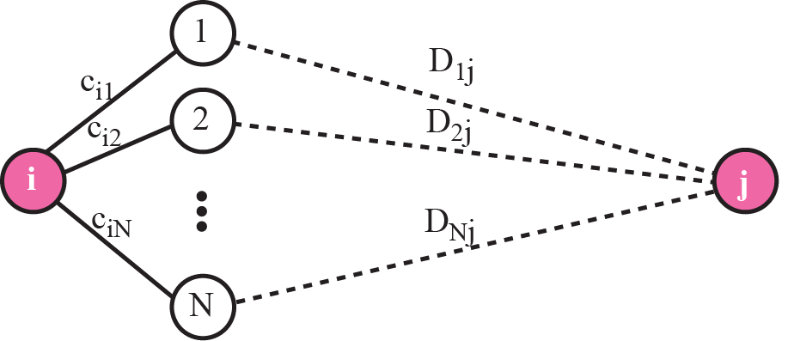
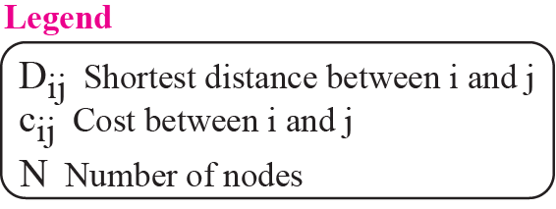
Figure 11.4 The fact behind Bellman-Ford algorithm
The algorithm is based on the fact that if all neighbors of node know the shortest distance to node j, then the shortest distance between node i and j can be found by adding the distance between node i and each neighbor to the neighbor’s shortest distance to node j and then select the minimum
TCP/IP Protocol Suite

Slide 7
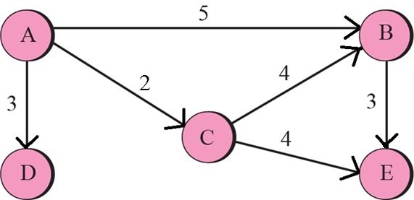
Figure 11.3 A graph for Bellman-Ford algorithm
Edge List: (A, B) (A, D) (A, C) (B,E) (C,B) (C,E)
If d(u) + C(u,v) < d(v), then d(v) = d(u) + C(u,v)
TCP/IP Protocol Suite

Slide 8

Figure 22.14 Distance vector routing tables
In distance vector routing, the least-cost route between any two nodes is the route with minimum distance. Each node maintains a vector (table) of minimum distances to every node.
22.<number>

Slide 9

Figure 22.15 Initialization of tables in distance vector routing
Each node can know only the distance between itself and its immediate neighbors, those directly connected to it.
22.<number>

Slide 10

Figure 22.16 Updating in distance vector routing
‘A’ wants to reach to itself via ‘C’ :- Cost is 2+2 =4
‘A’ wants to reach to ‘B’ via ‘C’ :- Cost is 2+4 = 6
22.<number>

Slide 11

Note
In distance vector routing, each node shares its routing table with its
immediate neighbors periodically and when there is a change.
22.<number>

Slide 12
When to Share ?
The question now is, When does a node send its partial routing table (only two columns) to all its immediate neighbors?
Periodic Update : A node sends its routing table, normally every 30 s, in a periodic update. The period depends on the protocol that is using distance vector routing.
Triggered Update : A node sends its two-column routing table to its neighbors anytime there is a change in its routing table.
The change can result from the following:
1. A node receives a table from a neighbor, resulting in changes in its own table after updating.
2. A node detects some failure in the neighboring links which results in a distance change to infinity.
22.<number>

Slide 13

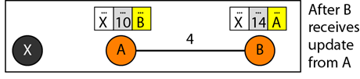

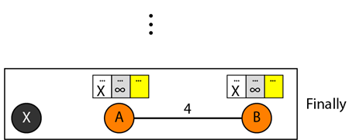

Count to infinity problem: Two-node instability
22.<number>

Slide 14
Solution
Defining Infinity : 16 : However, this means that the distance vector routing cannot be used in large systems. The size of the network, in each direction, can not exceed 15 hops.
Split Horizon: In this strategy, instead of flooding the table through each interface, each node sends only part of its table through each interface.
In our scenario, node B eliminates the last line of its routing table before it sends it to A. In this case, node A keeps the value of infinity as the distance to X. Later when node A sends its routing table to B, node B also corrects its routing table. The system becomes stable after the first update: both node A and B know that X is not reachable.
Split Horizon and Poison Reverse: Normally, the distance vector protocol uses a timer, and if there is no news about a route, the node deletes the route from its table.
Node B can still advertise the value for X, but if the source of information is A, it can replace the distance with infinity as a warning: "Do not use this value; what I know about this route comes from you."
22.<number>

Slide 15
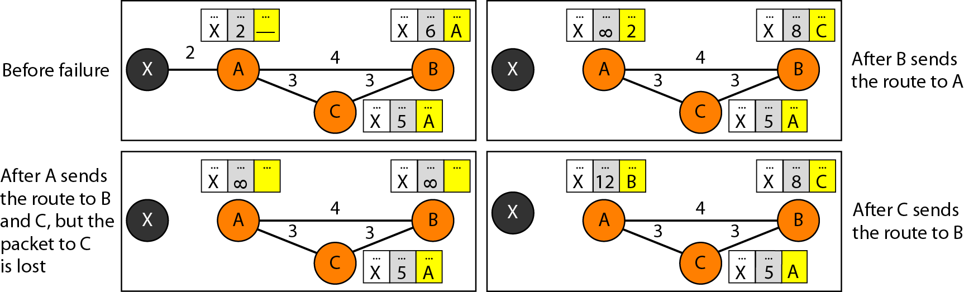
Count to infinity problem: Three-node instability
22.<number>

Slide 16
RIP
The Routing Information Protocol (RIP) is an intradomain routing protocol used inside an autonomous system.
RIP implements distance vector routing directly with some considerations:
In an autonomous system, we are dealing with routers and networks (links). The routers have routing tables; networks do not.
2. The first column defines a network address.
3. The metric used by RIP is the distance is defined as the number of links (networks) to reach the destination. For this reason, the metric in RIP is called a hop count.
4. Infinity is defined as 16, which means that any route in an autonomous system using RIP cannot have more than 15 hops.
5. The next-node column defines the address of the router to which the packet is to be sent to reach its destination.
22.<number>

Slide 17
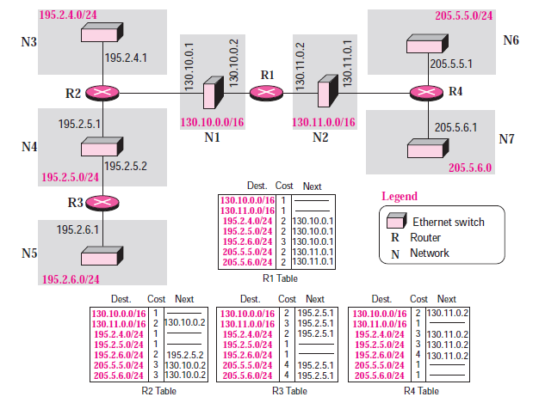
Figure 22.19 Example of a domain using RIP
22.<number>

Slide 18

Figure 22.20 Concept of link state routing
Link state routing has a different philosophy from that of distance vector routing. In link state routing, if each node in the domain has the entire topology of the domain the list of nodes and links, how they are connected including the type, cost (metric), and condition of the links (up or down)-the node can use Dijkstra's algorithm to build a routing table.
22.<number>

Slide 19

Figure 22.21 Link state knowledge
A picture of the whole domain is known to each node.
22.<number>

Slide 20
Building Routing Tables
In link state routing, four sets of actions are required:
Creation of the states of the links by each node, called the link state packet (LSP).
2. Dissemination of LSPs to every other router, called flooding,
in an efficient and reliable way.
3. Formation of a shortest path tree for each node.
4. Calculation of a routing table based on the shortest path
tree.
22.<number>

Slide 21

Creation of link state packet (LSP)
LSP carries: the node identity, the list of links, a sequence number, and age.
The first two, node identity and the list of links, are needed to make the topology.
The third, sequence number, facilitates flooding and distinguishes new LSPs from old ones.
The fourth, age, prevents old LSPs from remaining in the domain for a long time.
LSPs are generated on two occasions:
When there is a change in the topology of the domain: Triggering of LSP.
On a periodic basis: The timer set for periodic dissemination is normally in the range of 60 min or 2 hr based on the implementation. A longer period ensures that flooding does not create too much traffic on the network.
22.<number>

Slide 22
Flooding of LSPs
After a node has prepared an LSP, it must be disseminated to all other nodes, not only to its neighbors.
Process of flooding:
The creating node sends a copy of the LSP out of each interface.
2. A node that receives an LSP compares it with the copy it may already have. If then newly arrived LSP is older than the one it has (found by checking the sequence number), it discards the LSP.
If it is newer, the node does the following:
a. It discards the old LSP and keeps the new one.
b. It sends a copy of it out of each interface except the one from which the packet arrived. This guarantees that flooding stops somewhere in the domain.
22.<number>

Slide 23
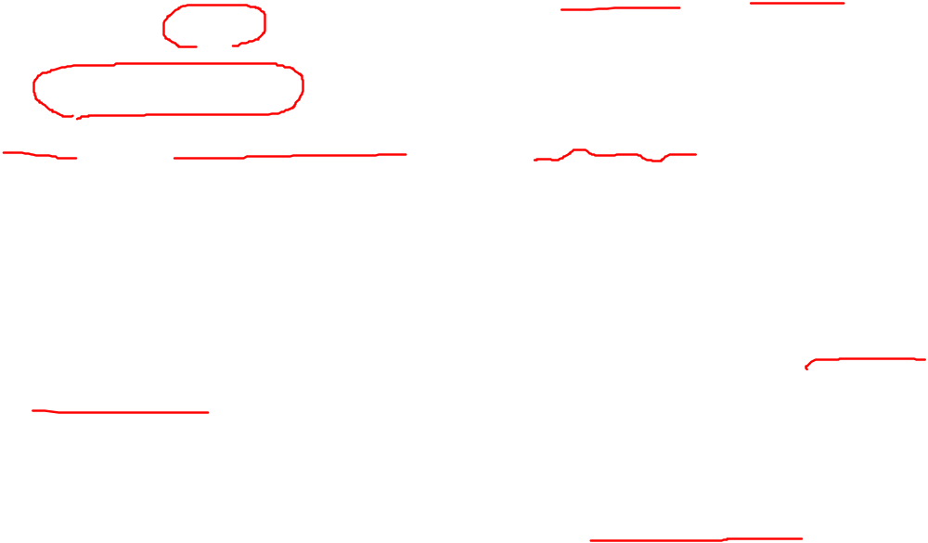
Formation of Shortest Path Tree: Dijkstra Algorithm
A shortest path tree is a graph of nodes and links; one node is called the root.
A shortest path tree is a tree in which the path between the root and every other node is the shortest.
The Dijkstra algorithm creates a shortest path tree from a graph.
The algorithm divides the nodes into two sets: tentative and permanent.
It finds the neighbors of a current node, makes them tentative, examines them, and if they pass the criteria, makes them permanent.
22.<number>

Slide 24


Figure 22.22 Dijkstra algorithm
22.<number>

Slide 25
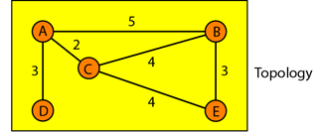
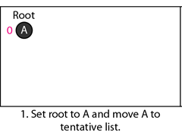
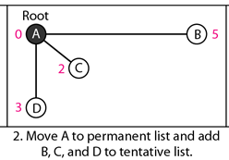
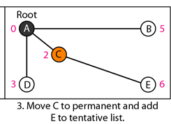
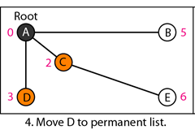
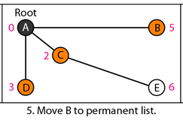
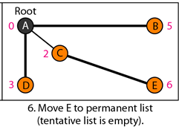
Figure 22.23 Example of formation of shortest path tree
PL: empty TL: A(0)
PL: A(0) TL: B(5), C(2), D(3)
PL: A(0), C(2)
TL: B(5), D(3), E(6)
PL: A(0), C(2), D(3)
TL: B(5), E (6)
PL: A(0), B(5),
C(2), D(3)
TL: E(6)
PL: A(0), B(5),
C(2), D(3), E(6)
TL: empty
22.<number>

Slide 26

Table 22.2 Routing table for node A
22.<number>

Slide 27

OSPF
Area: The Open Shortest Path First or OSPF protocol is an intradomain routing protocol based on link state routing. OSPF divides an autonomous system into areas.
Metric : The OSPF protocol allows the administrator to assign a cost, called the metric, to each route. The metric can be based on a type of service (minimum delay, maximum throughput, and so on).
22.<number>

Slide 28
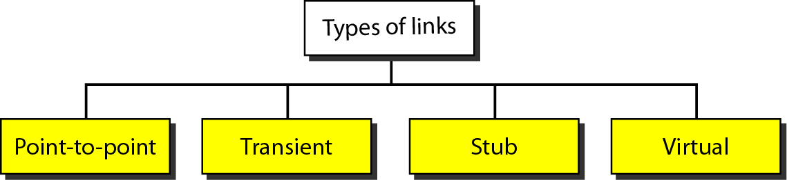
Figure 22.25 Types of links
22.<number>

Slide 29
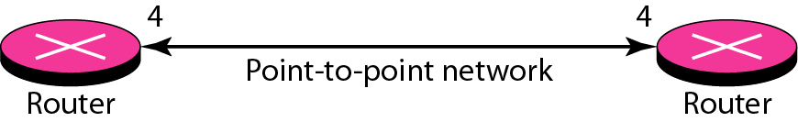
Figure 22.26 Point-to-point link
22.<number>

Slide 30
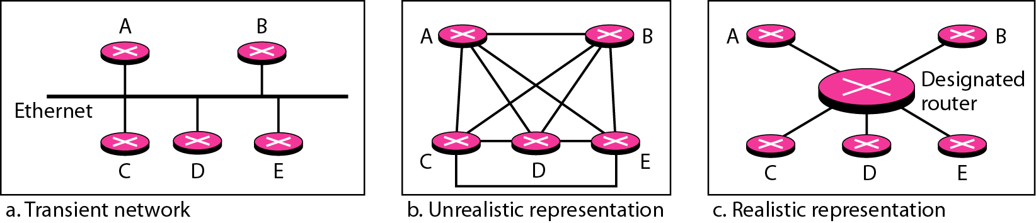
Figure 22.27 Transient link
22.<number>

Slide 31
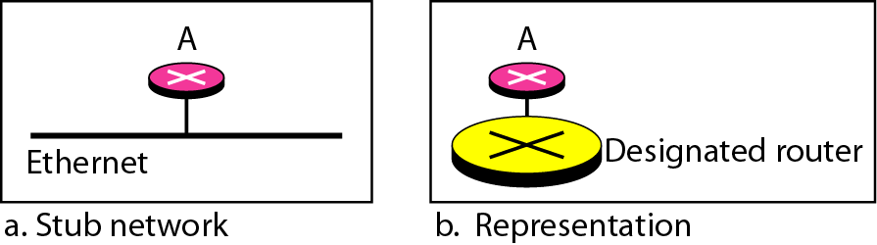
Figure 22.28 Stub link
22.<number>

Slide 32
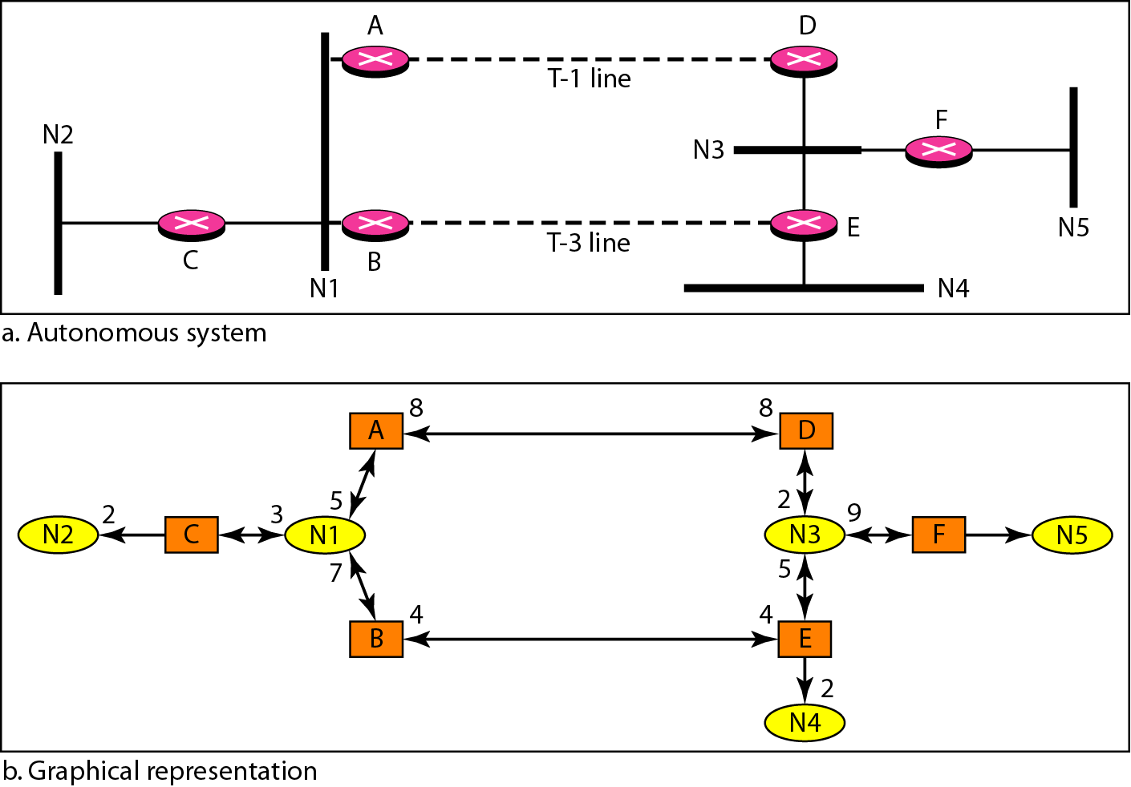
Figure 22.29 Example of an AS and its graphical representation in OSPF
1.544 Mbps
44.736 Mbps
22.<number>

Slide 33
Path Vector Routing
Path vector routing is interdomain routing.
There is one node in each autonomous system (AS) called as a speaker node.
The speaker node creates a routing table and advertises it to speaker nodes in the neighboring ASs.
Only speaker nodes in each AS can communicate with each other.
A speaker node advertises the path, not the metric of the nodes.
22.<number>

Slide 34
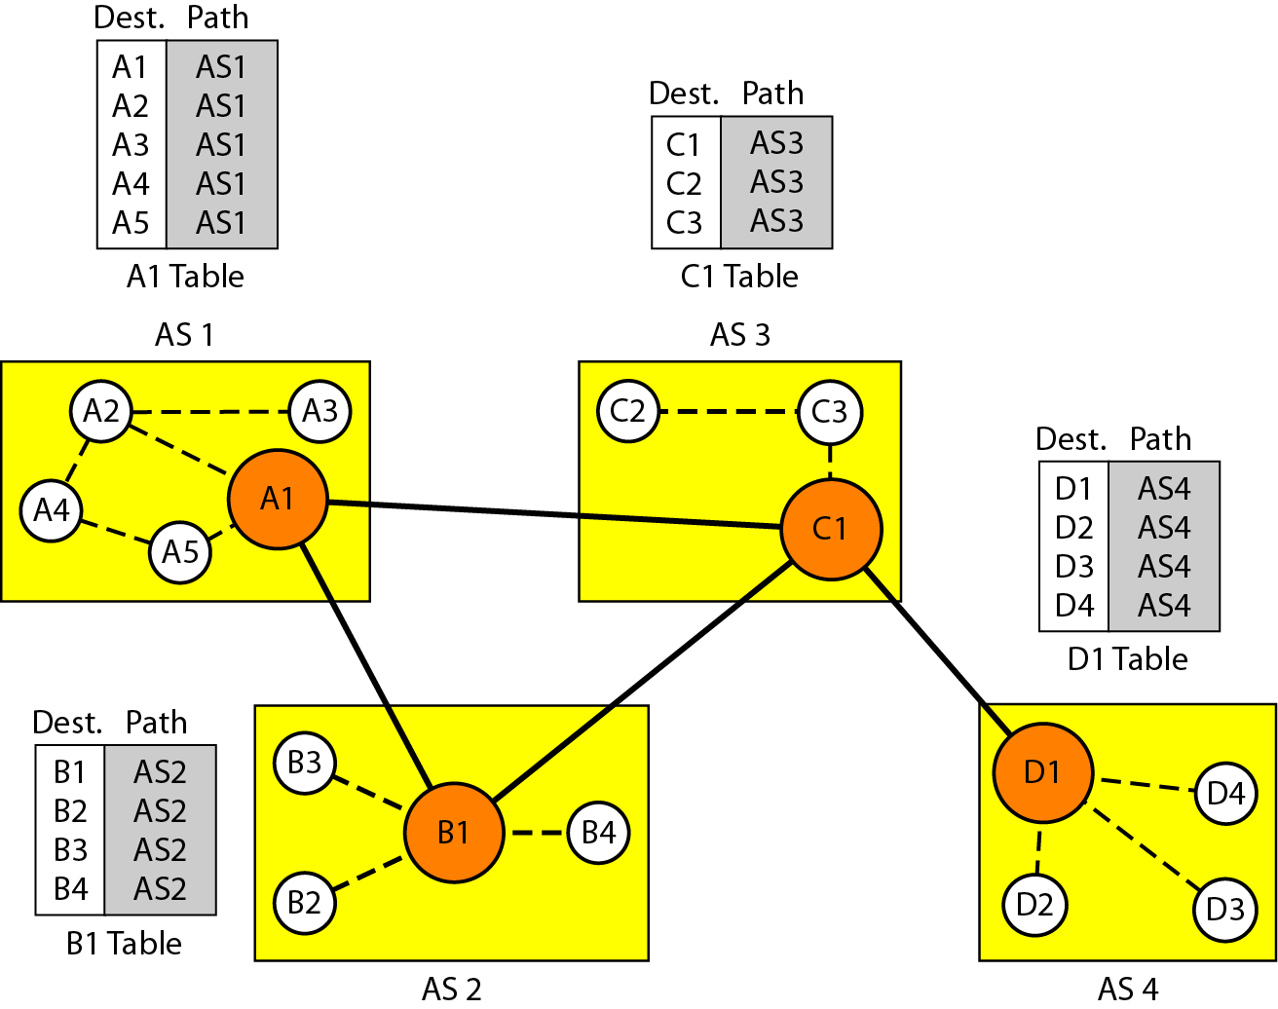
Figure 22.30 Initial routing tables in path vector routing
Initialization: At the beginning, each speaker node can know only the reachability of nodes inside its autonomous system (AS).
Sharing: After initialization, speaker in an autonomous system shares its table with immediate neighbors.
22.<number>

Slide 35
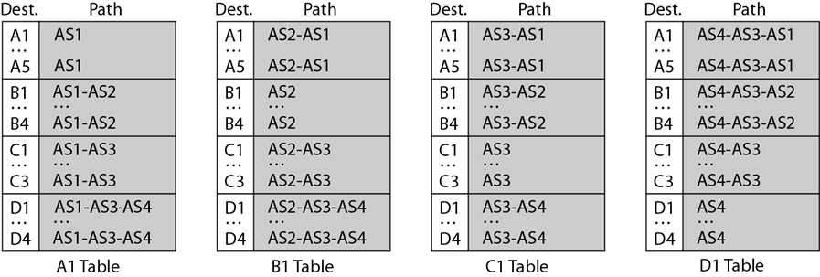
Figure 22.31 Stabilized tables for three autonomous systems
Updating: When a speaker node receives a two-column table from a neighbor, it updates its own table by adding the nodes
22.<number>

Slide 36
Path Vector Routing
Loop prevention: Creation of loops can be avoided in path vector routing. When a router receives a message, it checks to see if its autonomous system is in the path list to the destination. If it is,
looping is involved and the message is ignored.
Policy routing: When a router receives a message, it can check the path. If one of the AS listed in the path is against its policy, it can ignore that path and that destination. It does not update its routing table with this path, and it does not send this message to its neighbors.
Optimum path: It cannot include metrics in this route because each AS that is included in the path may use a different criterion for the metric. We chose the one that had the smaller number of AS, but this is not always the case. Other criteria, like security, safety, and reliability, can also be applied.
22.<number>

Slide 37
Border Gateway Protocol (BGP)
BGP is an interdomain routing protocol using path vector routing.
Types of Autonomous Systems:
Stub AS: A stub AS has only one connection to another AS. The interdomain data traffic in a stub AS can be either created or terminated in the AS. Data traffic, however, cannot pass through a stub AS.
Multihomed AS : A multihomed AS has more than one connection to other ASs, but it is still only a source or sink for data traffic. It can send data traffic to more than one AS, but there is no transient traffic. It does not allow data coming from one AS and going to another AS to pass through.
Transit AS: It is a multihomed AS that also allows transient traffic. Good examples of transit ASs are national and international ISPs (Internet backbones).
22.<number>

Slide 38
Border Gateway Protocol (BGP)
: Path Attributes:
1. Wellknown attribute: It is one that every BGP router must recognize.
2. An optional attribute: It is one that needs not be recognized by every router.
Well-known attribute: mandatory and discretionary
A well-known mandatory attribute is one that must appear in the description of a route.
A well-known discretionary attribute is one that must be recognized by each router, but is not required to be included in every update message.
22.<number>

Slide 39
Border Gateway Protocol (BGP)
: Path Attributes:
One well-known mandatory attribute is ORIGIN. This defines the source of the routing information (RIP, OSPF, and so on).
Another well-known mandatory attribute is AS_PATH. This defines the list of AS through which the destination can be reached.
Another well-known mandatory attribute is NEXT-HOP, which defines the next router to which the data packet should be sent.
22.<number>

Slide 40
Border Gateway Protocol (BGP)
: Path Attributes:
The optional attributes can also be subdivided into two categories: transitive and nontransitive.
An optional transitive attribute is one that must be passed to the next router by the router that has not implemented this attribute.
An optional nontransitive attribute is one that must be discarded if the receiving router has not implemented it.
22.<number>

Slide 41
Border Gateway Protocol (BGP)
:BGP Sessions
A session is a connection that is established between two BGP
routers only for the sake of exchanging routing information.
A session at the BGP level, as an application program, is a connection at the TCP level to create reliable environment.
When a TCP connection is created for BGP, it can last for a long time, until something unusual happens. For this reason BGP sessions are sometimes referred to as semi-permanent connections.
22.<number>

Slide 42
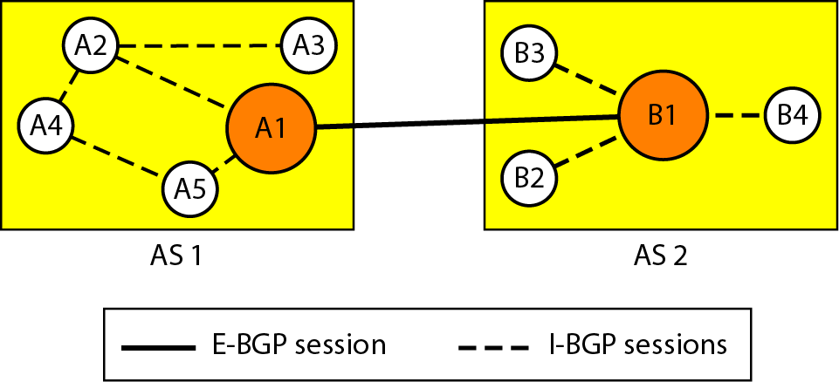
Figure 22.32 Internal and external BGP sessions
BGP can have two types of sessions: external BGP (E-BGP) and internal BGP (I-BGP) sessions.
The E-BGP session is used to exchange information between two speaker nodes belonging to two different autonomous systems. The I-BGP session, on the other hand, is used to exchange routing information between two routers inside an autonomous system.
22.<number>

